Slide 1
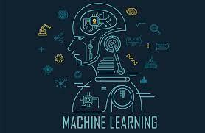
Introduction to
Dr. D. Sumathi

Slide 2
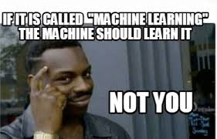
A FUNNY QUOTE WHICH I LIKE
Are we going to learn or making the machine to learn?

Slide 3
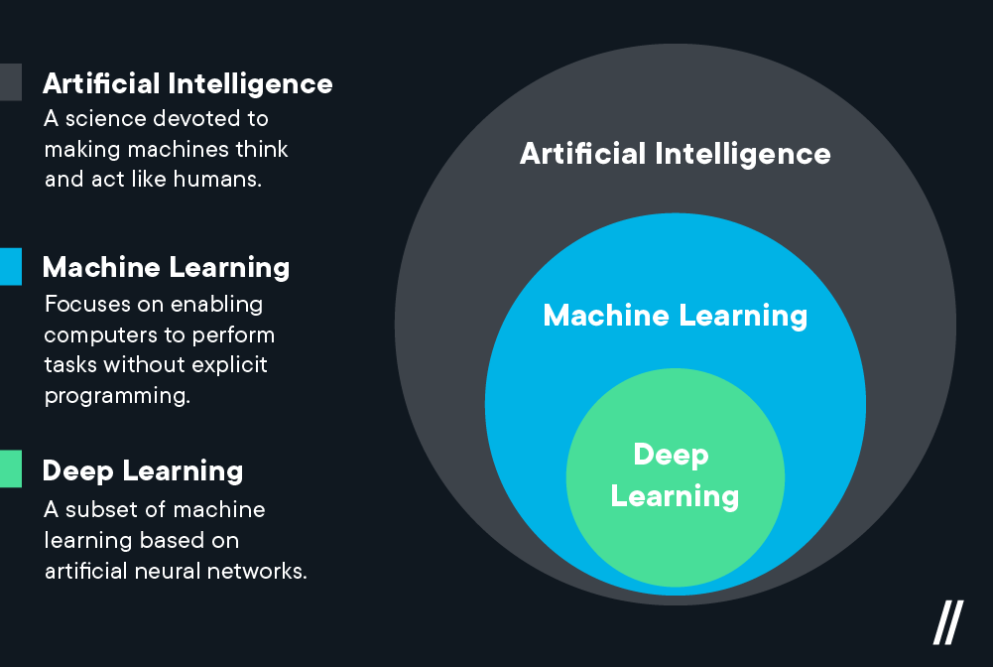
ML- Introduction
Machine learning is a method of data analysis that automates analytical model building.
It is a branch of artificial intelligence based on the idea that systems can learn from data, identify patterns and make decisions with minimal human intervention.

Slide 4
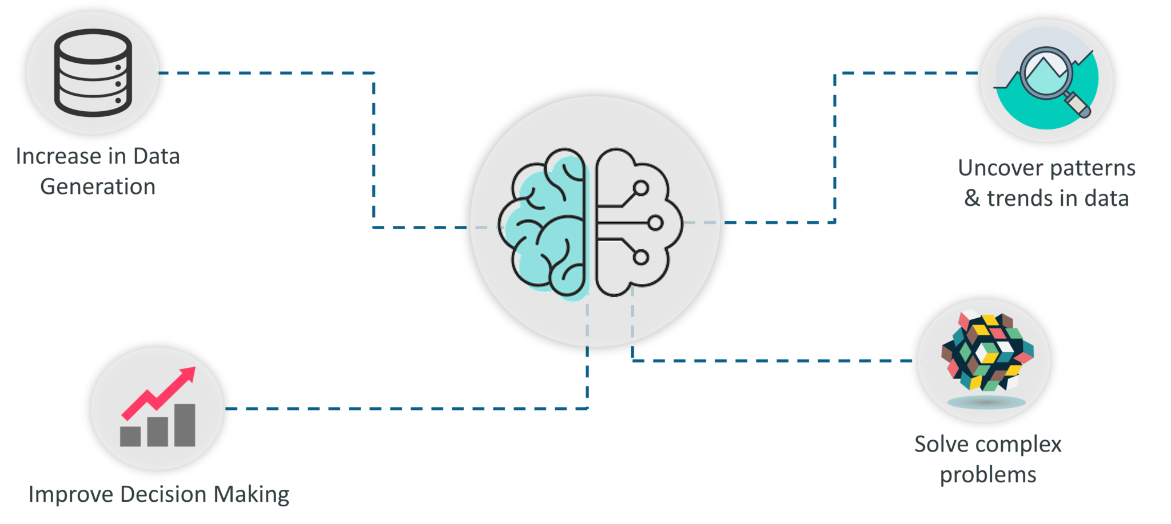

Slide 5
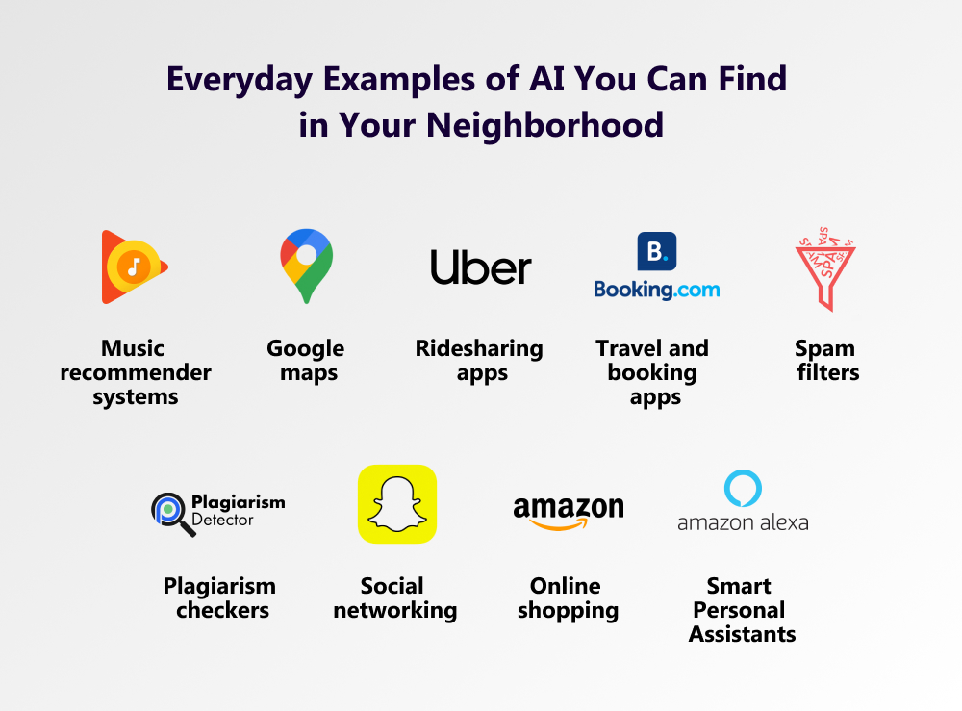
ML- Applications

Slide 6
Artificial Intelligence and Human Intelligence
“ Intelligence is the ability to adapt the change. “
Human Intelligence is a quality of mind to learn from past experience, adaptation to new situations, ability to change his own environment and handling abstract ideas from the gained knowledge.

Slide 7
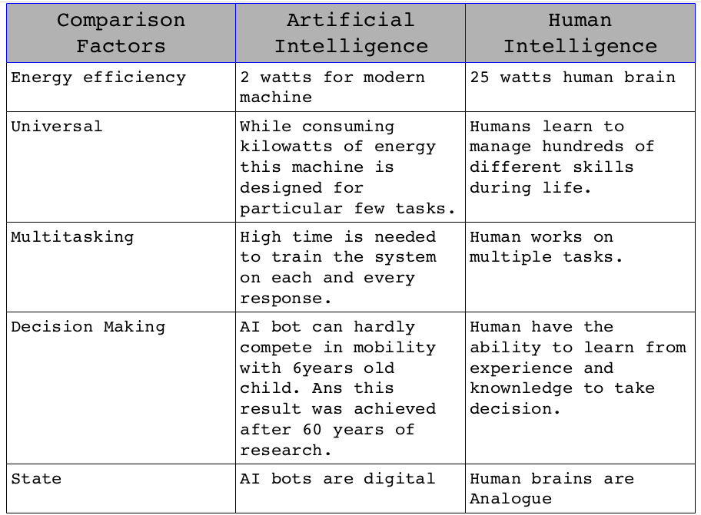

Slide 8
Intelligence vs Artificial Intelligence
Intelligence is a property/ability attributed to people, such as to know, to think, to talk, to learn, to understand.
Intelligence = Knowledge + ability to perceive, feel, comprehend, process, communicate, judge, learn.
Artificial Intelligence is an interdisciplinary field aiming at developing techniques and tools for solving problems that people at good at.

Slide 9
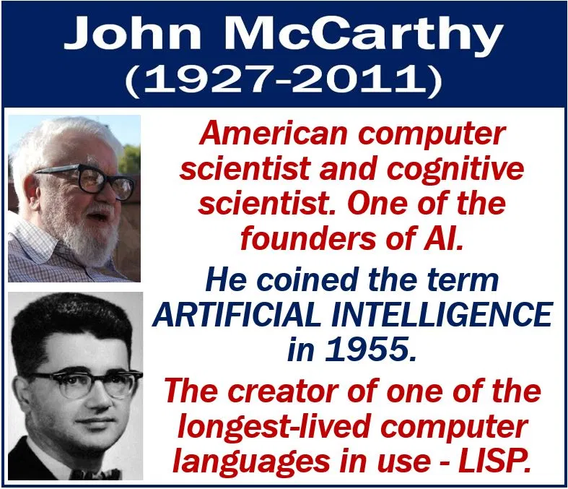
Definition of AI
Existing definitions advocate everything from replicating human intelligence to simply solving knowledge-intensive tasks.
Examples:
“Artificial Intelligence is the design, study and construction of computer programs that behave intelligently.” -- Tom Dean.
AI is defined as an experimental discipline utilizing the ideas and the methods of computation.

Slide 10
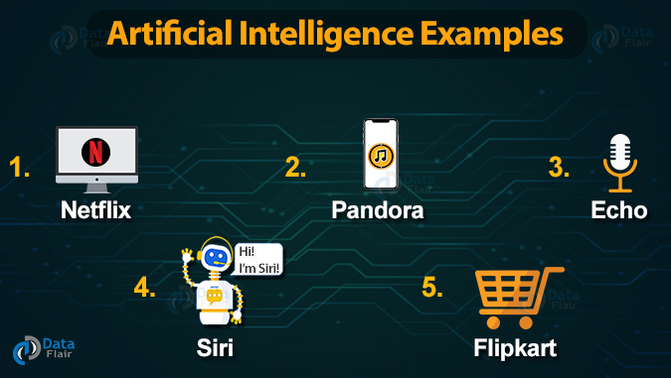
What Does AI Really Do?
Scientific goal: understand the mechanism behind human intelligence.
Engineering goal: develop concepts and tools for building intelligent agents capable of solving real world problems.
AI is an automated decision-making system, which continuously learns, adapts, suggests and takes actions automatically. AI requires algorithms which are able to learn from experience.
This is where Machine Learning [ML] comes into the picture.
https://www.youtube.com/channel/UCY4Gvrh2ENbFaBIFroJPEYA?feature=emb_ch_name_ex

Slide 11
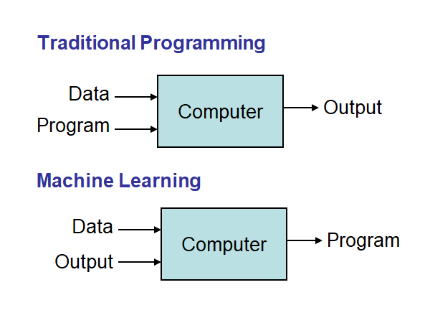
Definitions of Machine Learning
Machine learning is a branch of artificial intelligence based on the idea that systems can learn from data, identify patterns and make decisions with minimal human intervention.
A computer program that can learn from experience E with respect to some class of tasks T and performance measure P, so that its performance at tasks in T, as measured by P, improves with experience E.

Slide 12
AI vs ML
As the name says, artificial intelligence is incorporating human intelligence into machines. So, AI is a technique that enables machines to mimic human behavior. | Machine learning is the subset of AI that uses statistical methods to allow machines to improve their results with the amount of training data fed to it.
The focus is on improving learning capabilities along with thinking capabilities. | The focus is on improving learning capabilities.
AI consists of devices that can handle all sorts of tasks on their own. | ML as an extension to AI, analyses a series of algorithms to create a program that helps to automates actions.
The ultimate goal of AI is to embed intelligence in machines so that they can learn and think like humans to solve complex problems. | The ultimate goal of ML is to train machines with data so that they can learn, improve and give accurate results.
The scope of artificial intelligence is large, it contains fields like robotics, natural language processing, and expert systems | The scope of machine learning is limited, it consists of ML algorithms like the random forest, k-means, decision trees, support vector machines, etc.
The main objective of artificial intelligence is to maximize the chances of success and not accuracy. | The main objective of machine learning is to maximize the accuracy of predicted output and not the success ratio.

Slide 13
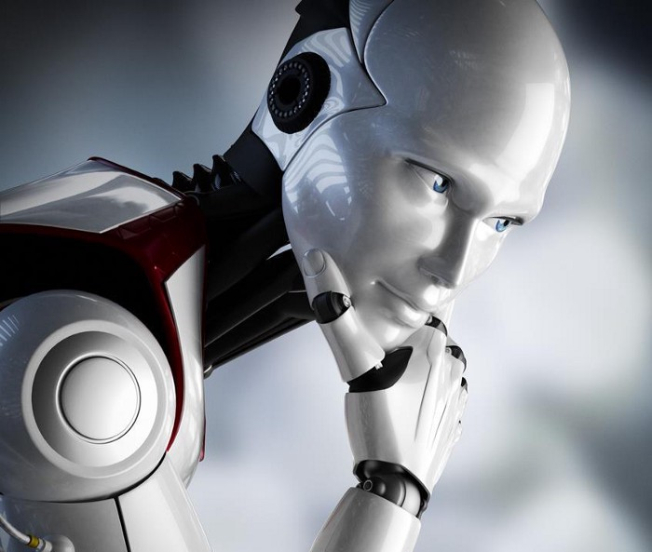

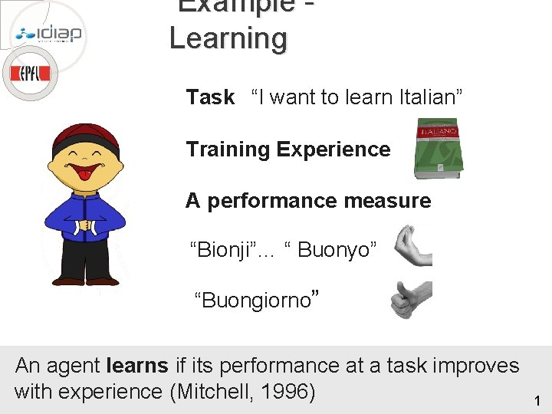
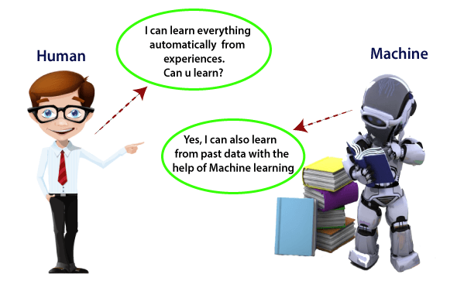
Definitions of Machine Learning

Slide 14
Examples
Automatic Translation of documents
Task- Translation
Experience – DIFFERENT TYPES OF LANGUAGES
Performance- efficient conversion
Traffic Prediction
traffic patterns at a busy intersection (task T),
a machine learning algorithm with data about past traffic patterns (experience E)
predicting future traffic patterns (performance measure P).

Slide 15
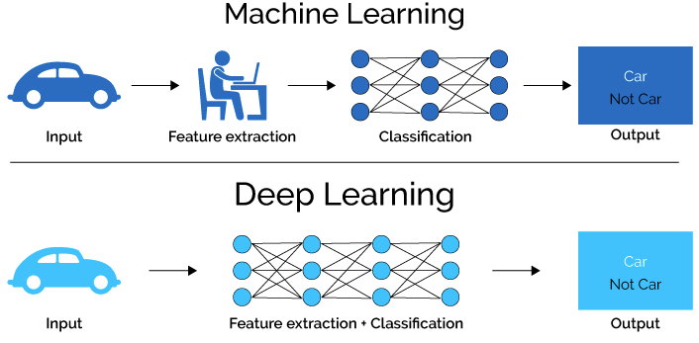
Machine Learning Vs Deep Learning

Slide 16
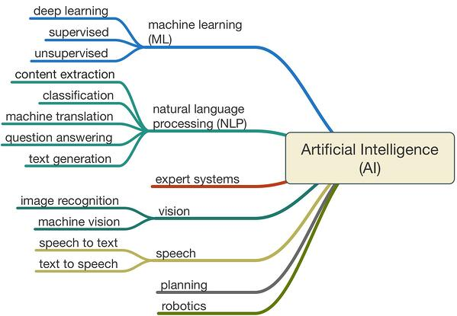

Slide 17
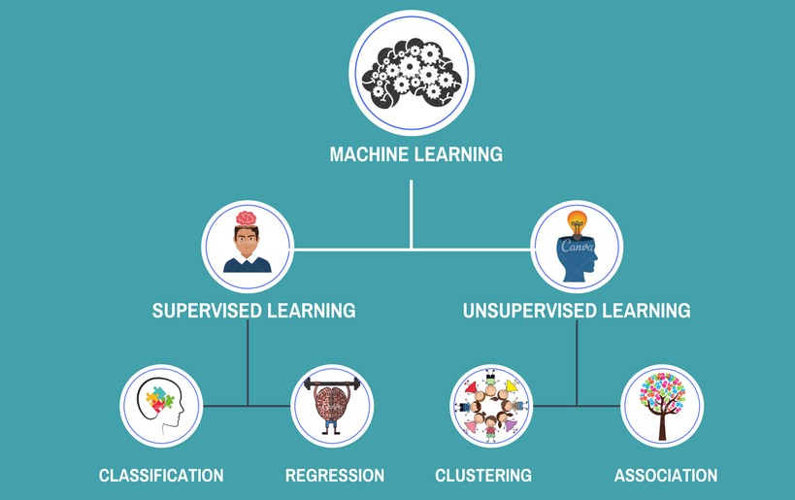
Types of Machine Learning(General)

Slide 18
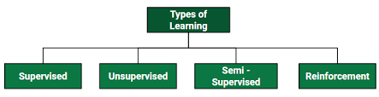

Slide 19
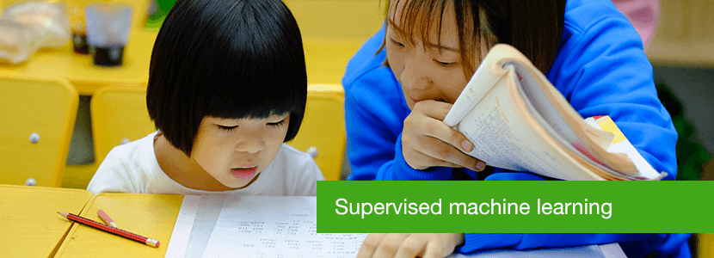
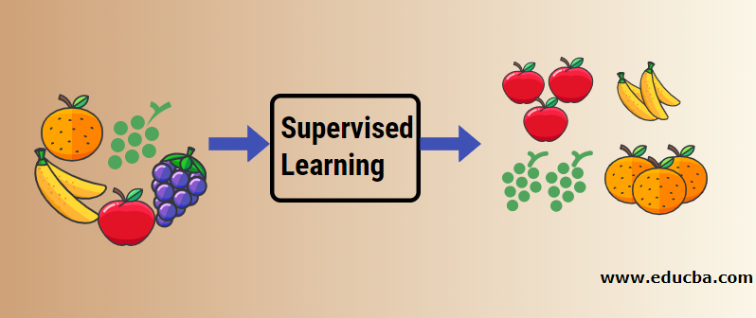
Supervised Machine Learning
you select what kind of information output (samples) to “feed” the algorithm;
what kind of results it is desired (for example “yes/no” or “true/false”).

Slide 20
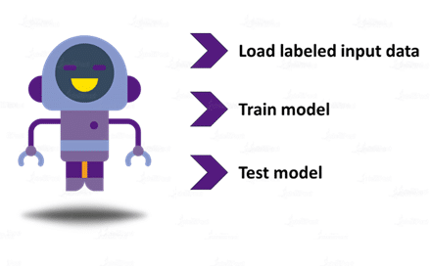
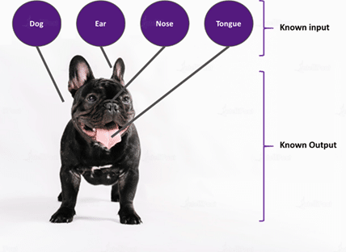

Slide 21
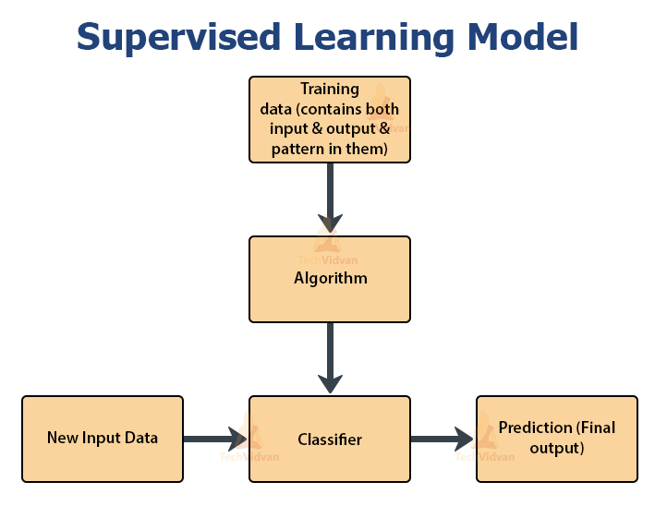
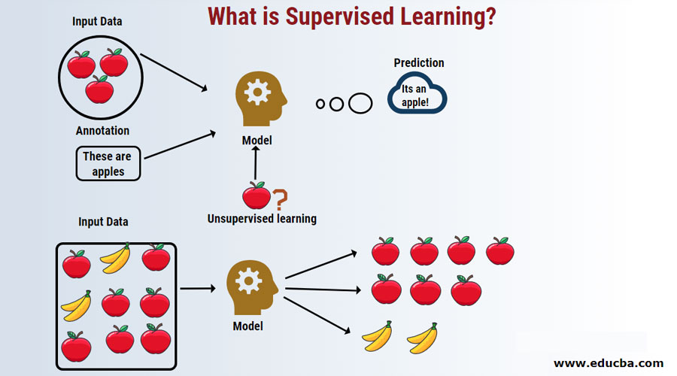

Slide 22
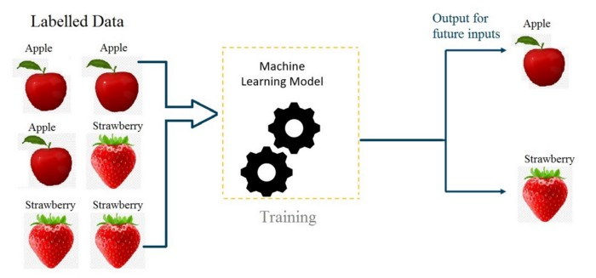
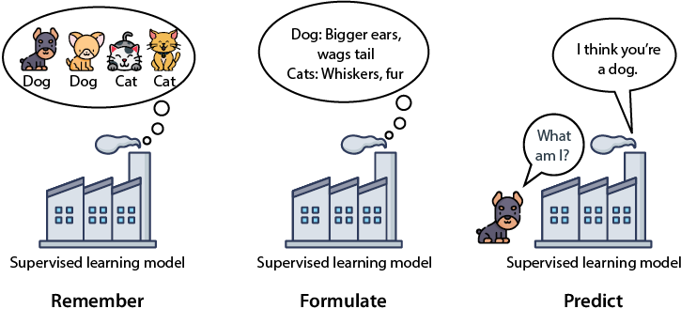
Supervised Learning Example
previously collected data is needed in order to train our models.
A model based on supervised learning would require both previous data and the previous results as input.
By training with this data, the model helps in predicting results that are more accurate.

Slide 23
Common methods of supervised learning
There are two main areas where supervised machine learning comes in handy: classification problems and regression problems
Classification refers to taking an input value and mapping it to a discrete value. In classification problems, our output typically consists of classes or categories. This could be things like trying to predict what objects are present in an image (a cat/ a dog) or whether it is going to rain today or not.
Regression
Regression is related to continuous data (value functions). In Regression, the predicted output values are real numbers. It deals with problems such as predicting the price of a house or the trend in the stock price at a given time, etc.

Slide 24
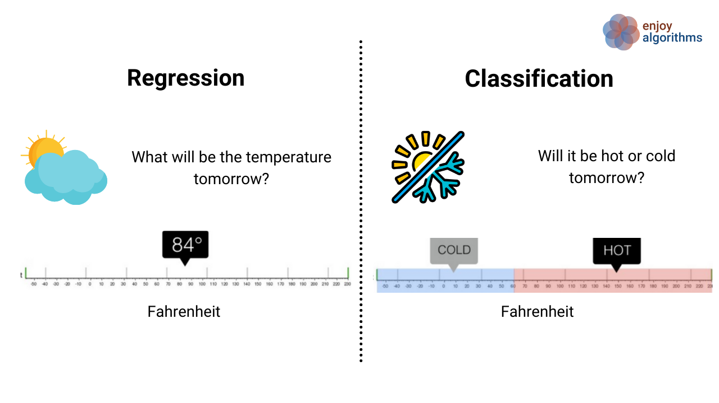
Examples for classification and regression

Slide 25
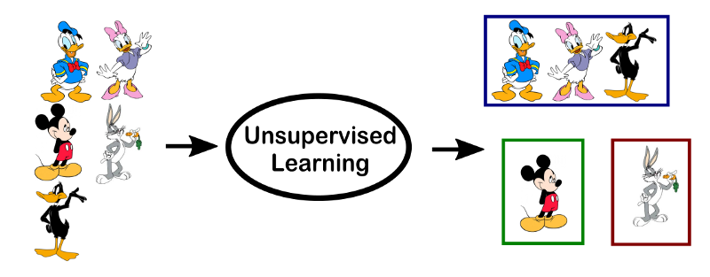
Unsupervised Learning Example
Unsupervised learning needs no previous data as input.
It is the method that allows the model to learn on its own using the data, which you give.
Here, the data is not labelled, but the algorithm helps the model in forming clusters of similar types of data.

Slide 26
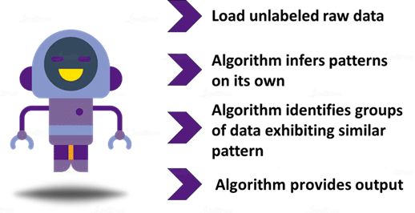
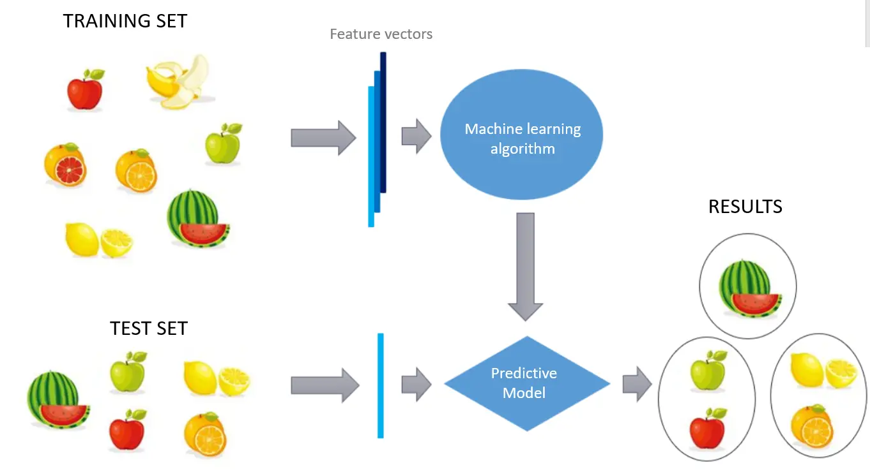
Unsupervised Learning

Slide 27
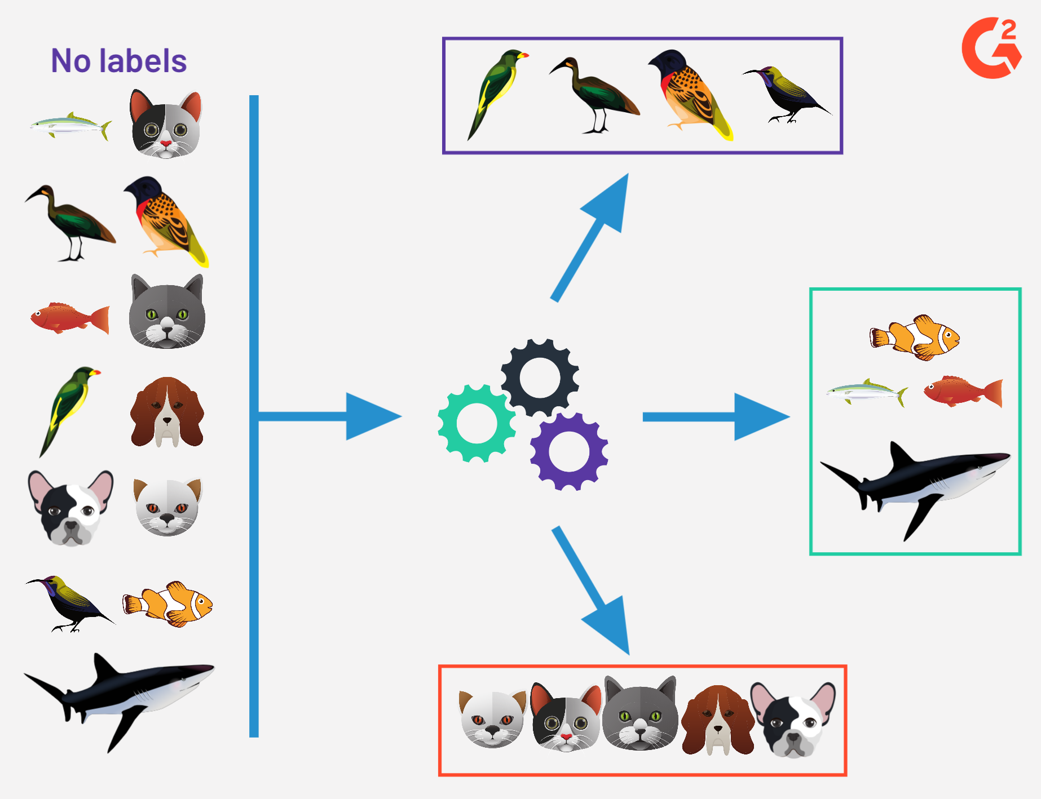

Slide 28
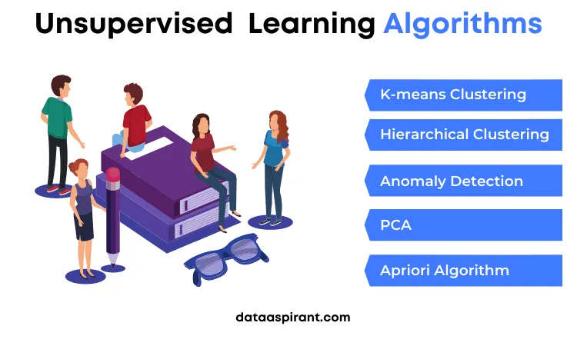

Slide 29
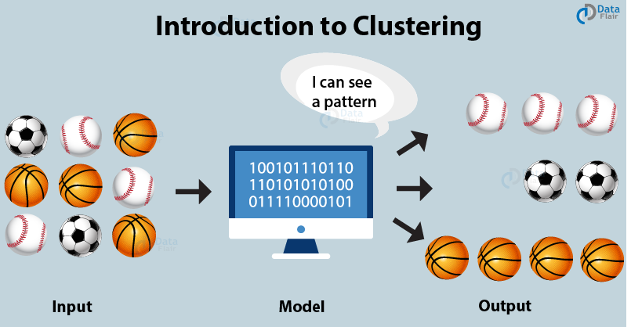

Slide 30
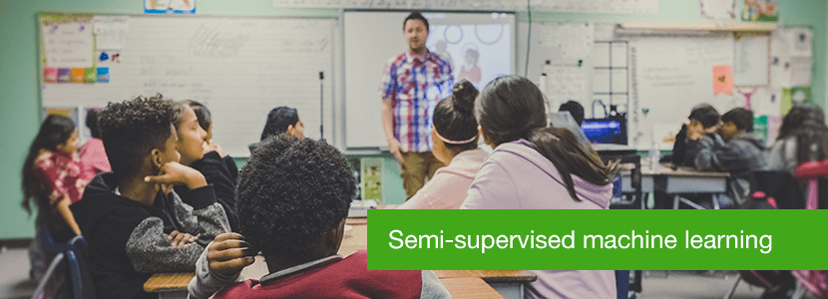
Semi Supervised Learning
Semi-supervised learning uses the classification process to identify data assets and the clustering process to group it into distinct parts.
The goal of semi-supervised learning is to enable the training of ML models by using a small labeled dataset and a large volume of unlabeled data.

Slide 31
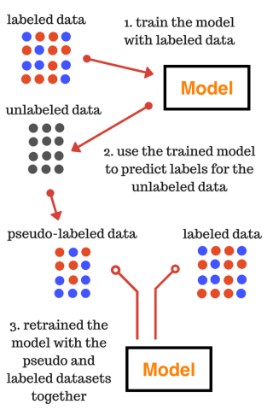
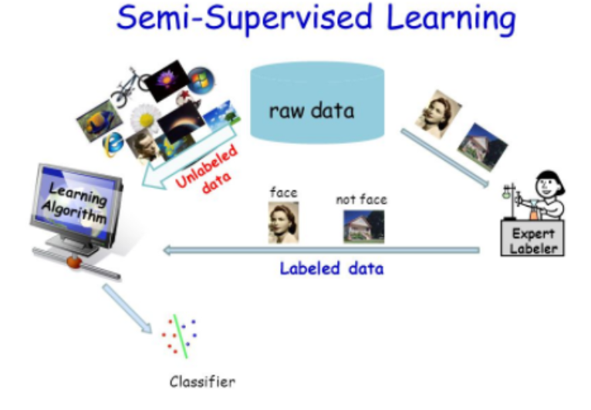
It uses a small amount of labeled data and a large amount of unlabeled data,
Avoids the challenges of finding a large amount of labeled data. That means you can train a model to label data without having to use as much labeled training data.

Slide 32
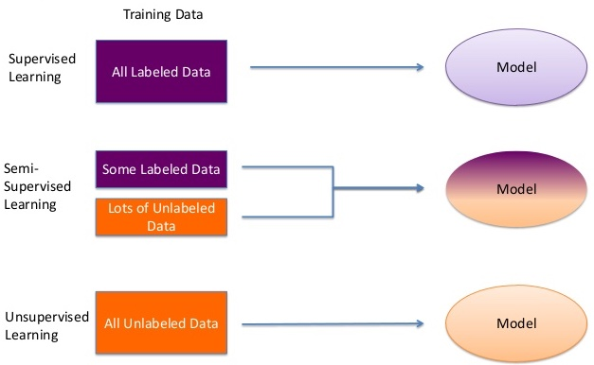

Slide 33
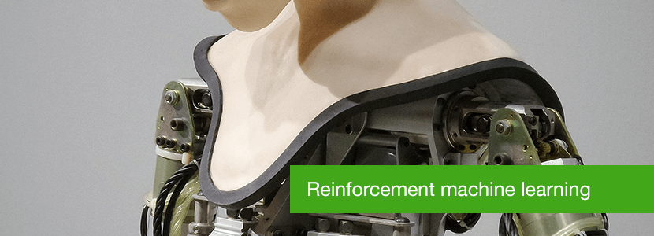
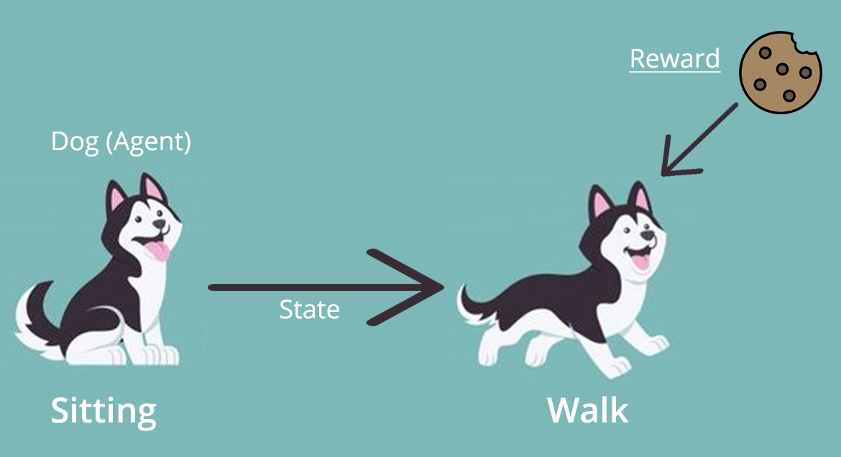

Slide 34

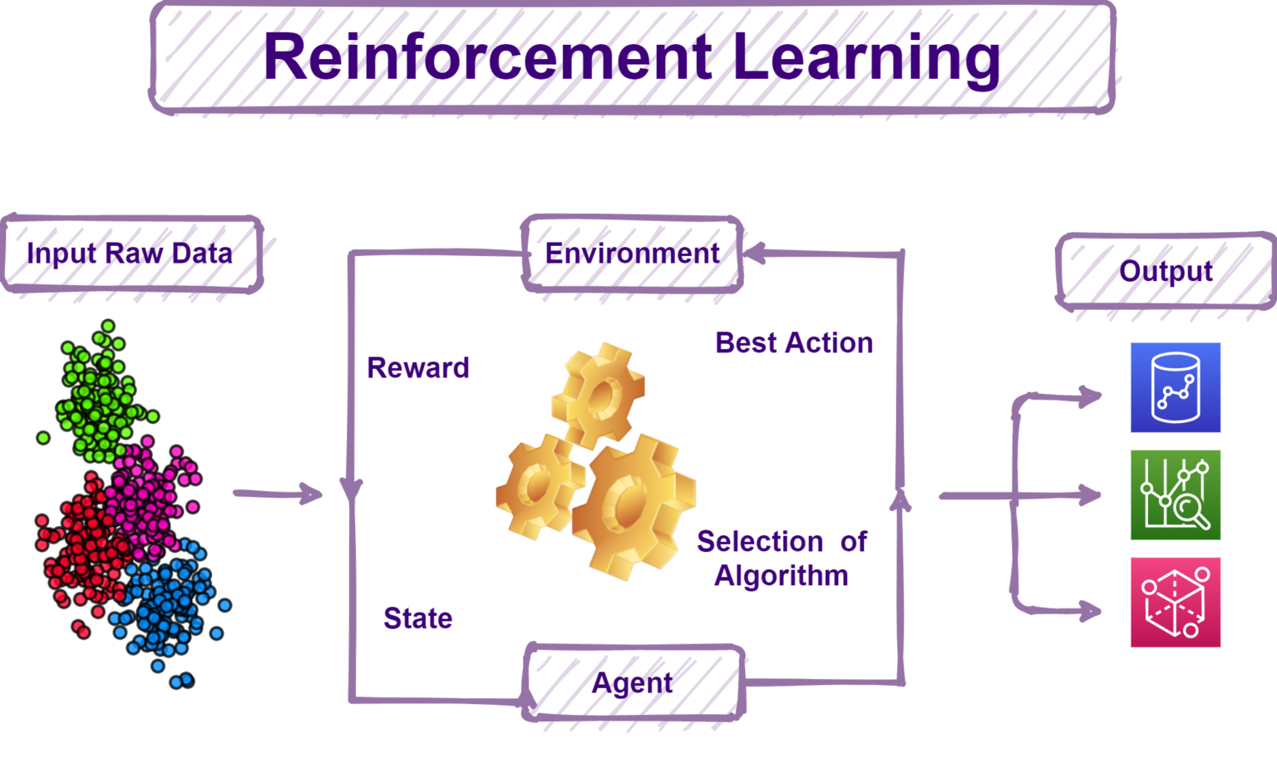

algorithms learn to react to an environment on their own

Slide 35
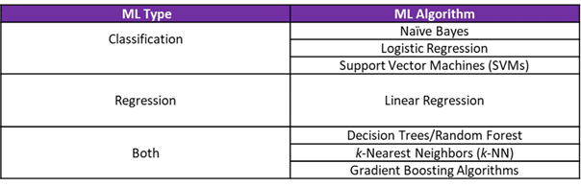

Slide 36
Components of a ML Algorithm
Model Structure (Representation) Linear Models
Decision trees
Ensembles of models
Instance based methods
Neural networks
Support vector machines
Graphical models (Bayes/Markov nets)
Etc.
Loss Function (Evaluation)
Accuracy
Precision and recall
Squared error
Likelihood
Posterior probability
Cost / Utility
Margin
Entropy
K-L divergence
Fitting Parameters (Optimization)
Greedy search
Gradient Descent
Linear Programming
Many variations

Slide 37
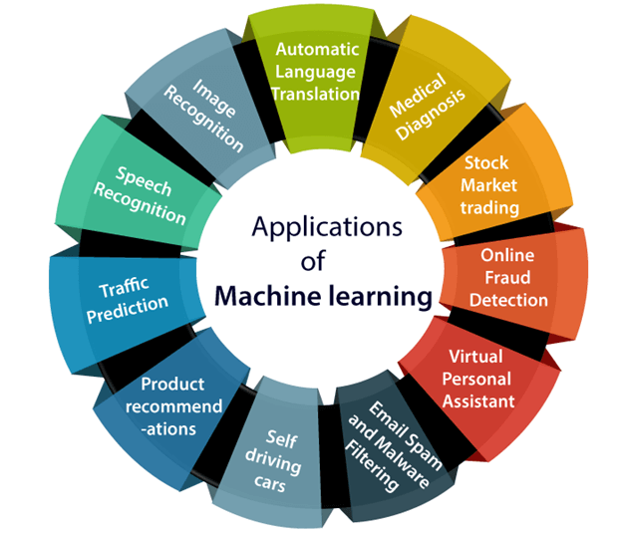
Successes of AI and Machine learning
Health Care
Web search
Finance / Trading
Marketing
Fraud and Security
E-commerce
Robotics
Social networks
Recommendations
NLP / Digital Assistants
‘Self Driving’ Cars
[Your favorite area]

Slide 38
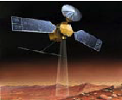
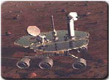
AI Applications
Autonomous Planning & Scheduling:
Autonomous rovers.

Slide 39
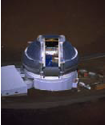

AI Applications
Autonomous Planning & Scheduling:
Telescope scheduling

Slide 40


AI Applications
Pattern recognition
Image analysis and enhancement

Slide 41

AI Applications
Transportation:
Autonomous vehicle control

Slide 42
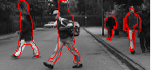
AI Applications
Transportation:
Pedestrian detection:

Slide 43

AI Applications
Games:

Slide 44
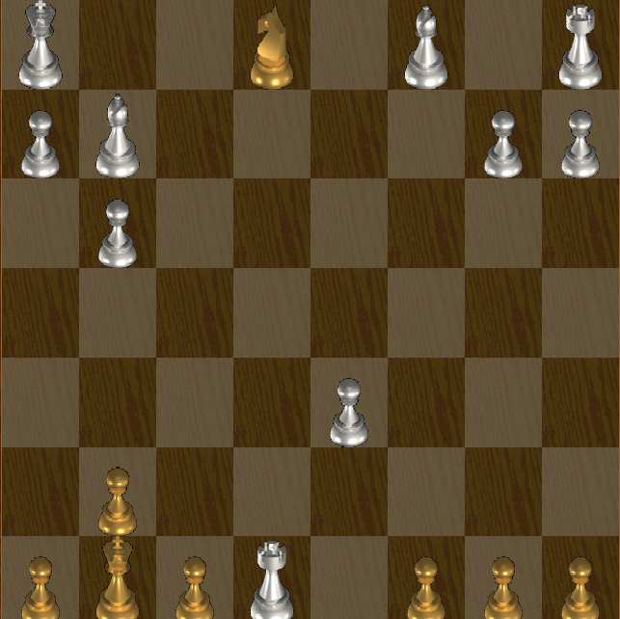
AI Applications
Games:

Slide 45
